Slide 1

Impact of Earthquakes on the Environment
Collapsing buildings
Property damage
Mud slides
Fires
Floods
Tsunamis
Loss of power

Slide 2

Impact of Hurricanes on the Environment
Erosion
Houses, buildings, and other structures destroyed
Heavy flooding of inland areas
Tornadoes
Loss of power
Contaminated water supply

Slide 3
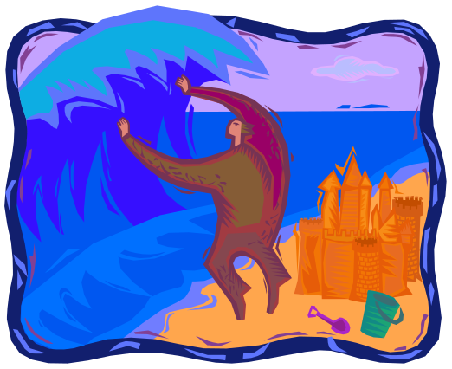
Impact of Tsunamis on the Environment
Houses, buildings, and other structures destroyed
Loss of power
Erosion
Fresh water contaminated

Slide 4
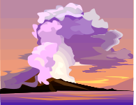
Impact of Volcanoes on the
Environment
Houses, buildings, and other structures destroyed
Fires
Toxic gases released into the atmosphere
Carbon dioxide emitted from volcanoes adds to the natural greenhouse effect.
Loss of habitat

Slide 5

Impact of floods the
Environment
Disease
Loss of habitat
Houses, buildings, and other structures destroyed
Household wastes get into the water system
Power outages

Slide 6

Impact of Droughts on the
Environment
Dried up lakes and other water sources
Loss of livestock and crops
Losses or destruction of fish and wildlife habitat
Lack of food and drinking water for wild animals
Increase in disease in wild animals, because of reduced food and water supplies
Migration of wild animals, leading to a loss of wildlife in some (drought-stricken) areas and too many wildlife in areas not affected by drought
Increased stress on endangered species
Lower water levels in reservoirs, lakes, and ponds
Loss of wetlands
More fires
Soil erosion due to wind

Slide 7
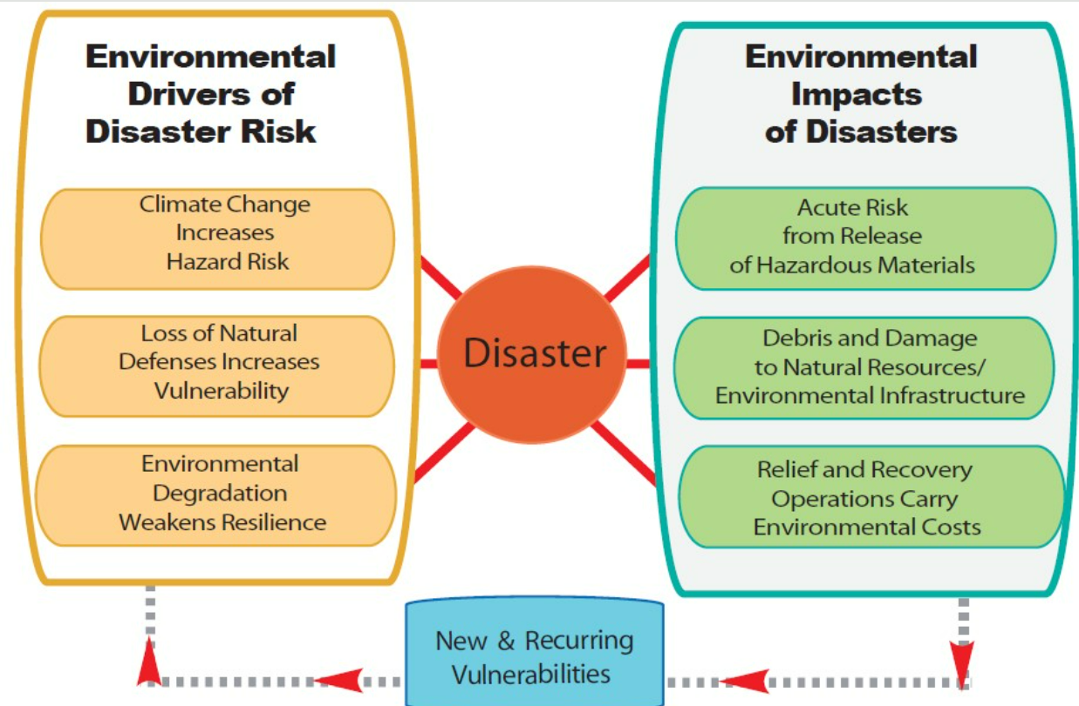

Slide 8
Physical Impacts of Disaster
Injuries
Death
Physical disability
Weakness
Fatigue
Loss of appetite

Slide 9
Social Impacts of Disaster
Disorganization of the family
Social isolation
Migration
Change in life style
Breakdown of traditional social life

Slide 10
Economic Impacts of Disaster
Unemployment
Loss of livelihood
Loss of crops
Loss of public infrastructure

Slide 11
Ecological Impact of Disaster
Climate change
Change in nutrient cycle
Invasive species
Disruption of ecological services

